Slide 1
Displaced in the Sun Belt
FLH at New America | June 10, 2021

Slide 2
Future of Land and Housing Program
The Future of Land and Housing Program at New America aims to help solve today’s property rights challenges, both at home and abroad.
Through our research, writing, and convening, we strive to connect new constituencies and shed light on underreported issues in the property rights space.

Slide 3
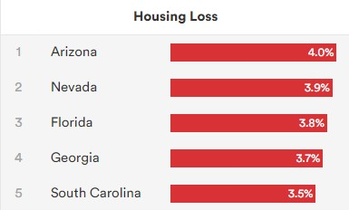
Why the Sun Belt?
Large Sun Belt metro areas accounted for almost half of all population growth in the U.S. between 2010 and 2016
Increasingly diverse: race and ethnicity; age of residents; socioeconomic strata; types of jobs added to the local economy
Housing prices in the Sun Belt are rising rapidly
Sun Belt metro areas account for six of the ten largest U.S. metros with the highest share of severely cost-burdened households
New America found that the Sun Belt had the highest housing loss rates in the country, driven by Arizona, Nevada, Florida, Georgia, and South Carolina
States With Highest Housing Loss (2014-2016)
Source: Eviction Lab & ATTOM

Slide 4
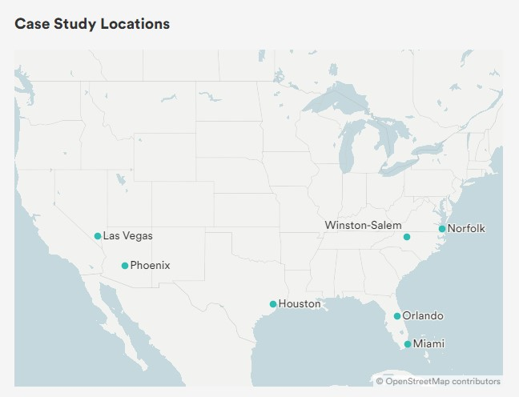
Displaced in the Sun Belt
We mapped and analyzed evictions and foreclosures across 7 case study locations in the U.S. South
Timeframe: 2017 - 2019
Unit of Analysis: Individual records, visualized and analyzed at the census tract level
We paired our analysis with qualitative interviews to understand the context behind the numbers
Why: Understanding where displacement was most acute and who was most impacted before the pandemic can help us better predict COVID-related housing loss

Slide 5
Findings:
Maricopa County, Arizona

Slide 6
Housing Insecurity in Maricopa County
Pre-Pandemic: Low Wages and High Rent
In 2019, the average rent for a two-bedroom apartment was above $1,000, roughly double what minimum wage workers could afford.
COVID-19 and Its Economic Downturn
Maricopa County was a national COVID-19 hotspot, and unemployment was 6.1 percent in November 2020, nearly double the level of joblessness during the same time in 2019.
Continued Loss of Income
26 percent of those surveyed in the Phoenix-Mesa-Chandler Metro Area expected a loss of income in early November 2020.

Slide 7
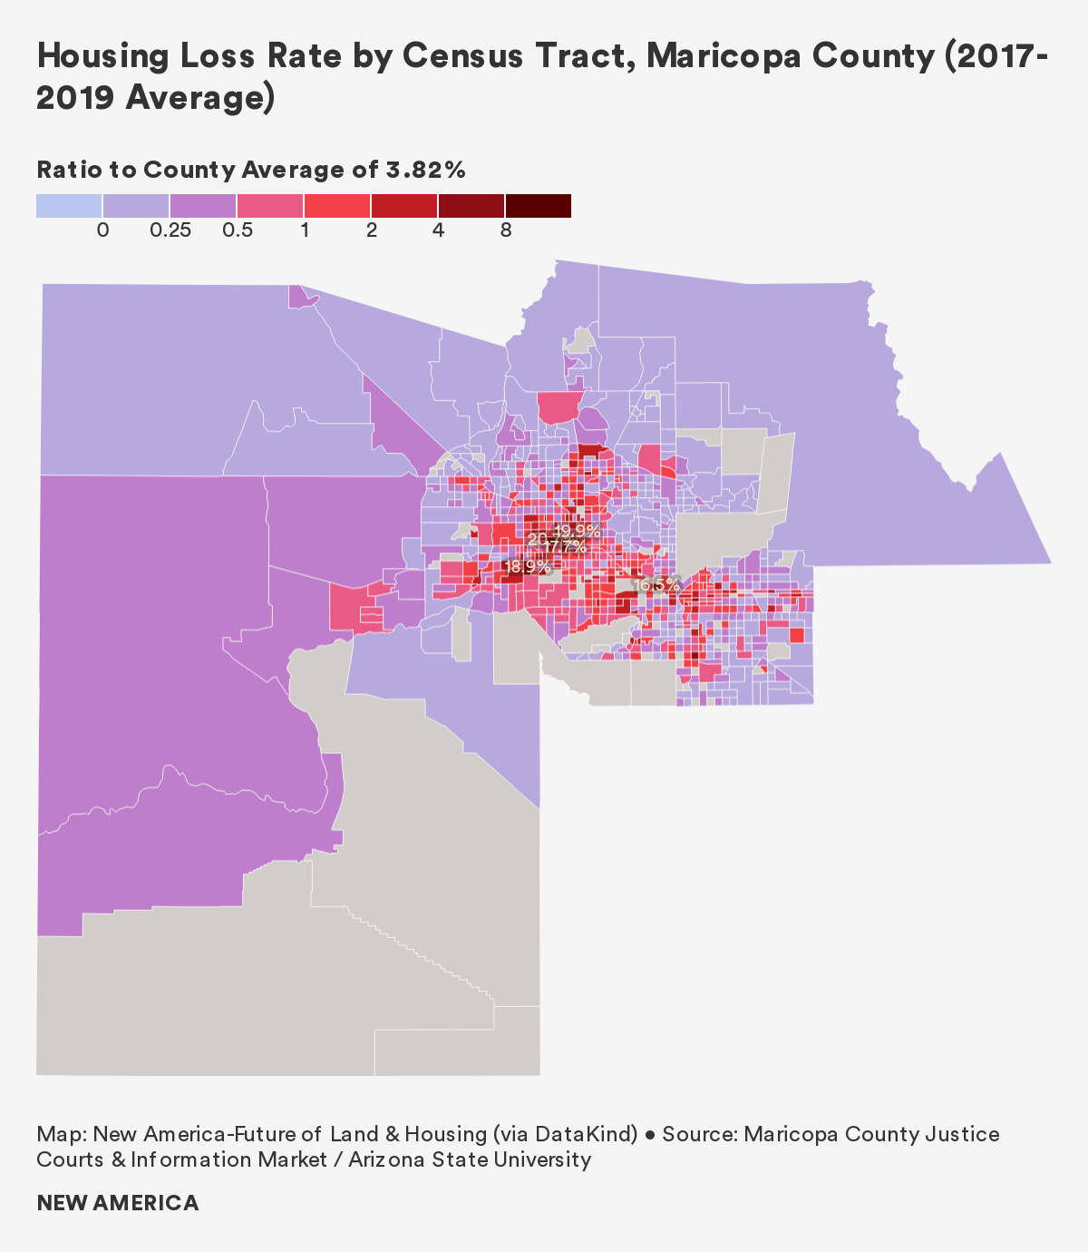
Housing Loss Rate (2017-2019 Average)
Housing Loss Rate: 3.8%
Or 125,000+ residents per year
Eviction Rate: 7.6%
96% of housing loss between 2017-2019
Foreclosure Rate: 0.3%
Source: Maricopa County Justice Courts & Information Market (via Arizona State University)

Slide 8
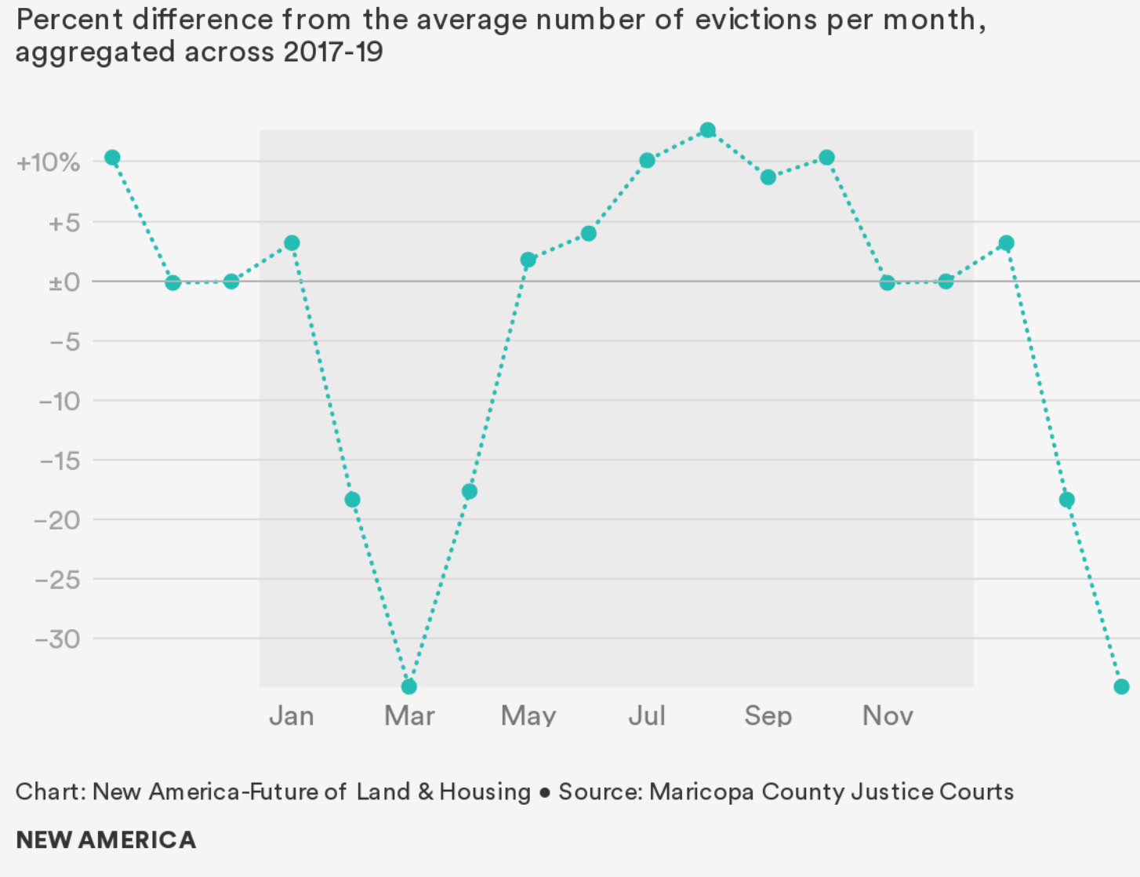
Maricopa County Evictions by Month (2017-2019 Average)
The August spike was a 53% increase over the March average
Why? We have three hunches:
Financial burden of high utility costs during hotter months
Increased costs of childcare and groceries during summer vacation
High demand for rental housing during the summer, causing landlords to move forward with evictions

Slide 9
Who is Losing their Home?
Traditionally Marginalized Communities
Census tracts containing more immigrant households, Latinx households, and single-mother households experienced higher rates of overall housing loss.
A Lack of Health Insurance
Of the census tracts with high rates of uninsured residents, nearly 80 percent had above average housing loss rates. Vulnerable households often can’t pay for housing and healthcare.
Reliance on Public Transportation
Dependence on unreliable public transportation systems can lead to repeated tardiness or absence from work, job loss, and a subsequent inability to pay for housing and other essentials.

Slide 10
Housing Loss amid COVID-19
At-Risk Populations Already Vulnerable
Consequences of job loss are especially severe amid COVID-19, as many laid-off wage workers find it difficult to become re-employed.
Rise in Housing Insecurity
The ongoing recession is also driving new groups into housing insecurity: middle-class households, self-employed individuals, and single parents.
Slow and Uneven Response
Cities and towns with populations under 500,000 did not receive CARES Act aid directly, and many lacked resources for funding and assistance.
Notes:
Interviews!

Slide 11
City of Tempe, Arizona

Slide 12
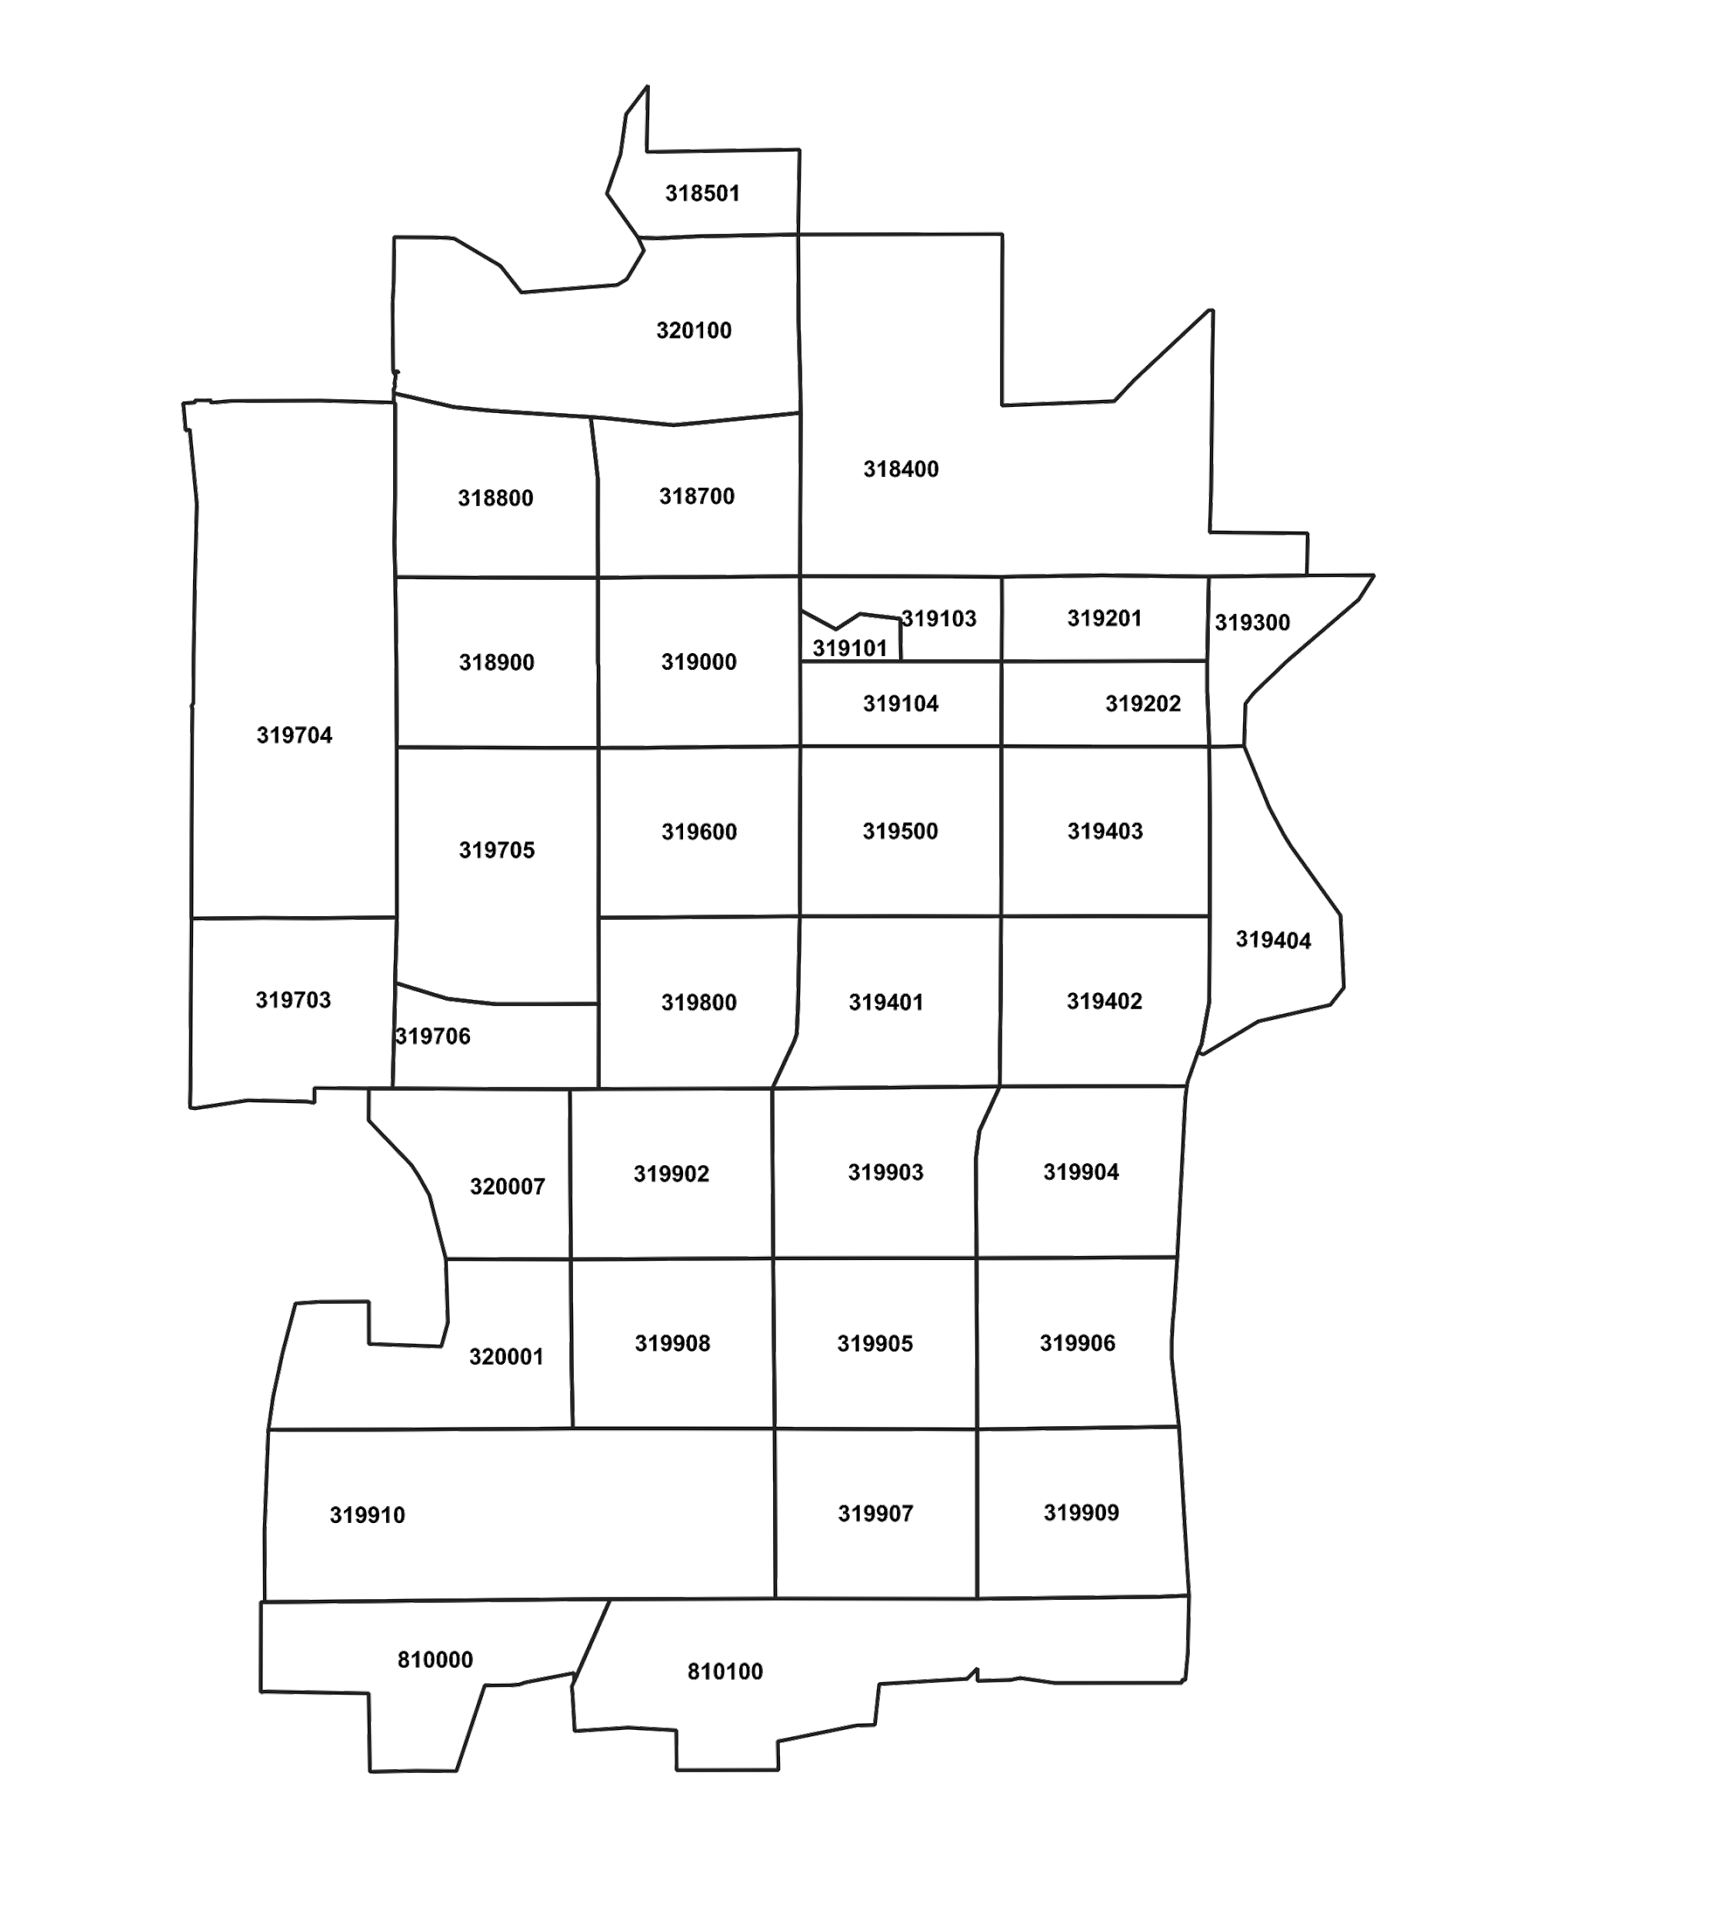
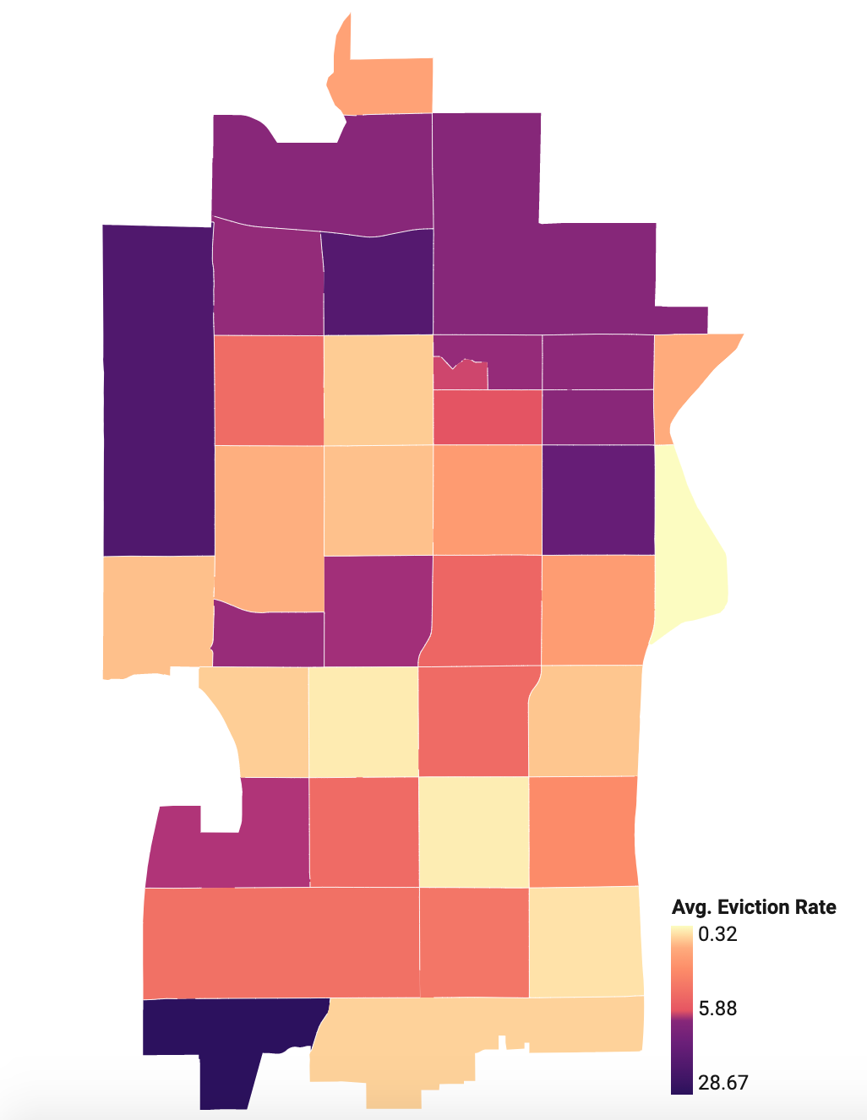
Tempe, Arizona: Eviction Rate by Census Tract (2017-2019 Average)
Census Tract | Eviction Rate (2017-2019 Avg.)
810000 | 28.7%
319704 | 20.8%
318700 | 19.8%
Source: Maricopa County Justice Courts

Slide 13
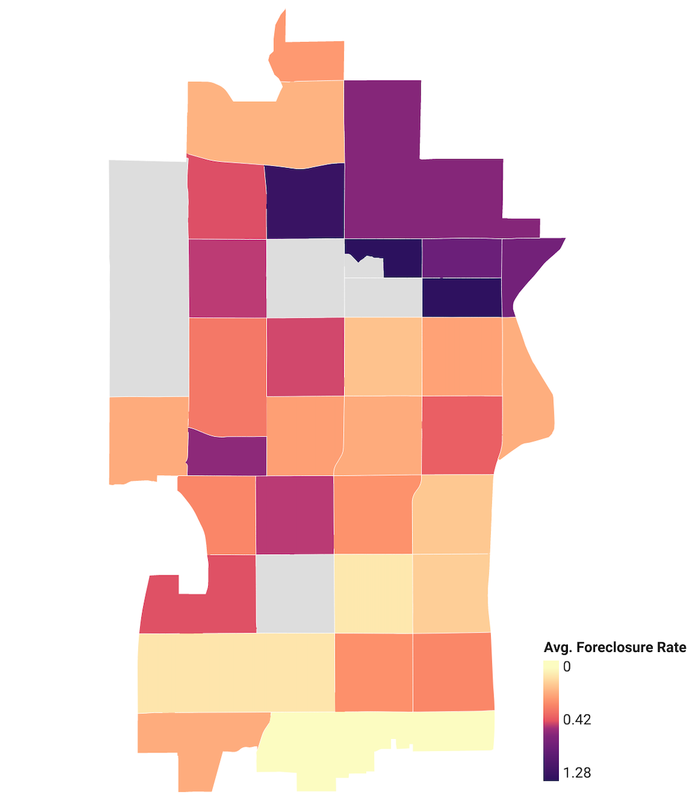
Tempe, Arizona: Foreclosure Rate by Census Tract (2017-2019 Average)
Census Tract | Foreclosure Rate (2017-2019 Avg.)
319202 | 1.3%
319103 | 1.3%
318700 | 1.2%
Source: Information Market (via Arizona State University)

Slide 14
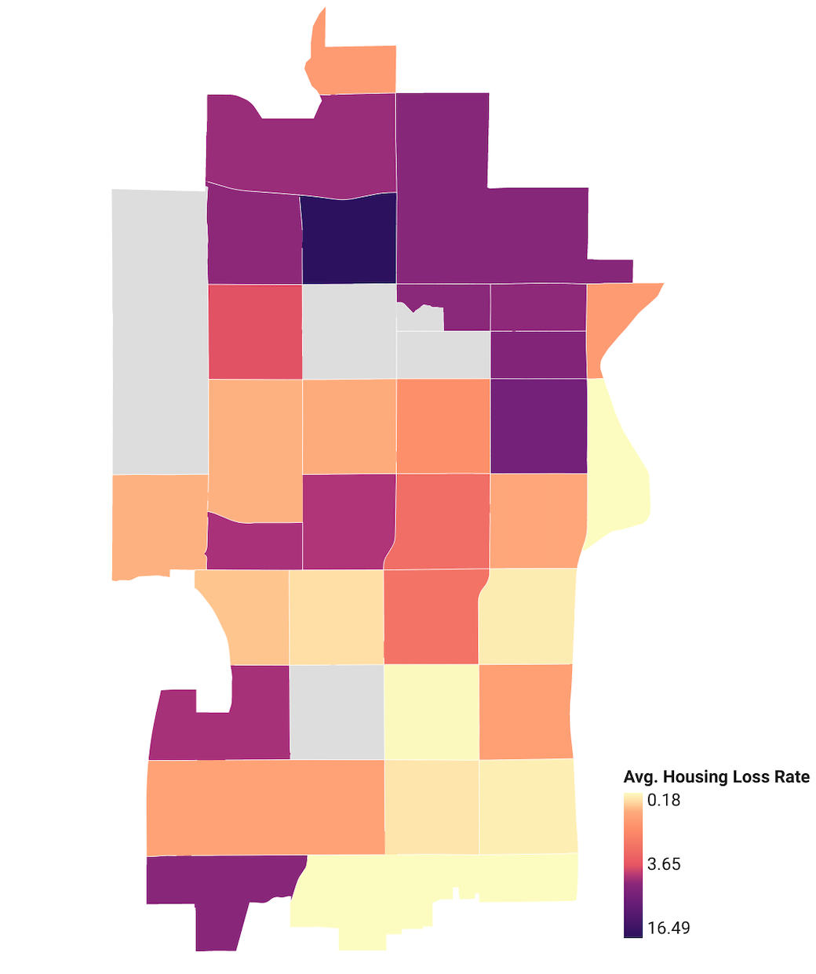
Tempe, Arizona: Housing Loss Rate by Census Tract (2017-2019 Average)
Census Tract | Housing Loss Rate (2017-2019 Avg.)
318700 | 16.5%
319403 | 9.3%
319202 | 7.8%
Source: Maricopa County Justice Courts & Information Market (via Arizona State University)

Slide 15
Tempe, Arizona & Housing Loss Data
Data Uses:
Target rent and utility aid with flyers/mailers and go “where people are”
Developing pro bono tenant representation in hard-hit neighborhoods
Equity in Action Leadership Training
Continued partnership with City of Tempe GIS staff, the Justice Courts

Slide 16
Thank you!
Contact: robustelli@newamerica.org

